Slide 1

Welcome
Notes:
Topic: Mindfulness
Time: 30 minutes
Purpose of training evolution: Sailors will explore the concept of mindfulness and how practicing daily mindfulness can help them to reduce stress and gain present moment awareness.
Expected outcome of training evolution: Sailors will learn how to increase their personal resilience and performance by incorporating mindfulness exercises into their weekly routines.
Safety: Inform Sailors of safety hazards in the training environment. For some topics, Sailors should be informed if there is a designated person to talk to if the Sailor feels compelled to leave the training.
Facilitator Actions:
Display slide.
Greet Sailors.
Introduce yourself and give any background on yourself that might be of interest.
Establish credibility.
Facilitator Instructions:
The slide deck acts as a guide to present a facilitated discussion that may include activities.
Best practice: Use the slide to develop interest in the subject matter. Do not read the slides word for word. The Sailors should be able read the text and understand the messaging presented in the graphics.
Facilitator notes are available for each slide to help the Facilitator deliver the topic.
Best practice: Use the Slide Show view to ensure the Facilitator notes are viewable.
The Facilitator notes are divided into general instructions for Facilitator Actions (mechanics of facilitation) and the Facilitator Content (Inform, Discuss, Perform, and Reference).
Best practice for Inform: Present facts, concepts, and procedures. Depending on the subject matter, these may be written as suggested talking points or scripted material (denoted by quotation marks).
Best practice for Discuss: Conduct large-group question and answer sessions or large-group, Facilitator-led activities. Depending on the subject matter, these may be written as questions with expected answers or scripted activities.
Best practice for Perform: Facilitate small-group, scenario-based or procedural activities. Depending on the subject matter, these may be written with specific actions the Sailors will take or general ways for the Facilitator to monitor the activities. The Facilitator will be provided with expected outcomes to ensure Sailors leave training with correct information.
Best practice for Reference: This is for Facilitator use only.

Slide 2
Introduction
Warrior Toughness
MIND • BODY • SPIRIT
Mindfulness
Notes:
Facilitator Actions:
Display slide.
Introduce topic.
Let Sailors know that they can leave the discussion if they have to for their own well-being.
Ensure that misinformation is corrected immediately.
Monitor the discussions of the Sailors throughout the training event.
Facilitator Content:
To build Warrior Toughness, Sailors will learn how to increase their personal resilience and performance by incorporating mindfulness exercises into their weekly routines.

Slide 3
Learning Objective
Employ mindfulness to produce deliberate responses in challenging environments.
Notes:
Facilitator Actions:
Display slide.
Neither Sailors nor Facilitator should read the objective out loud.
Facilitator Content: N/A

Slide 4

Mindfulness Activity
Notes:
Facilitator Actions:
Display slide.
Monitor the discussions of the Sailors.
Allotted time for activity: 5 minutes.
Facilitator Content:
Expected outcomes: Sailors will experience firsthand how controlled breathing has a direct impact on their ability to reset their mind, remove stress, and focus on the present moment through the practice of a mindfulness exercise.
Inform:
The following exercise demonstrates mindfulness and how controlled breathing can assist Sailors in releasing stress and focusing on present moment awareness.
Perform:
Instruct the Sailors to think about everything they need to do the next time they are on duty.
Ask the Sailors how they feel about the tasks they need to accomplish and if any of the tasks are stressful.
Advise the Sailors you are now going to facilitate a mindfulness exercise.
Instruct the Sailors to empty everything from their hands and close their eyes.
Dim the lights in the room if possible.
Instruct the Sailors to take a deep breath in, exhale, and perform the following tasks:
Unclench and relax your jaw.
Relax your shoulders.
Sit back in the seat with your back straight against the chair.
Plant your feet flat on the ground.
Put your hands in your lap.
Focus on your breathing.
Instruct the Sailors to count down from 20 to 1 on your mark. As they count down each number, ask them to breathe out and silently repeat the number in their mind without saying it out loud.
Instruct the Sailors to begin counting down.
As the Sailors silently count down, instruct them to do the following:
Imagine with each breath out that all of your stressful feelings and thoughts are leaving your body.
Imagine each breath is dissolving any stressful situations that are trying to appear in your mind.
Imagine a single, peaceful image that brings you happiness and focus on it.
Instruct the Sailors to sit quietly and focus with their eyes closed when they reach the number 1.
Discuss:
At the completion of the exercise, ask the Sailors to open their eyes. Ask the following questions:
Do you notice anything different?
Do you feel any different?
How do you feel about the upcoming tasks you need to perform on duty?
Is it any easier to focus without overthinking?
Perform:
Bring the lights back up in the room if they were dimmed.
Inform:
Explain to the Sailors that they just took their first step toward practicing mindfulness.
By using a controlled breathing technique, they were able to release tension and stress while intentionally focusing their mind on being present and aware in the moment.

Slide 5
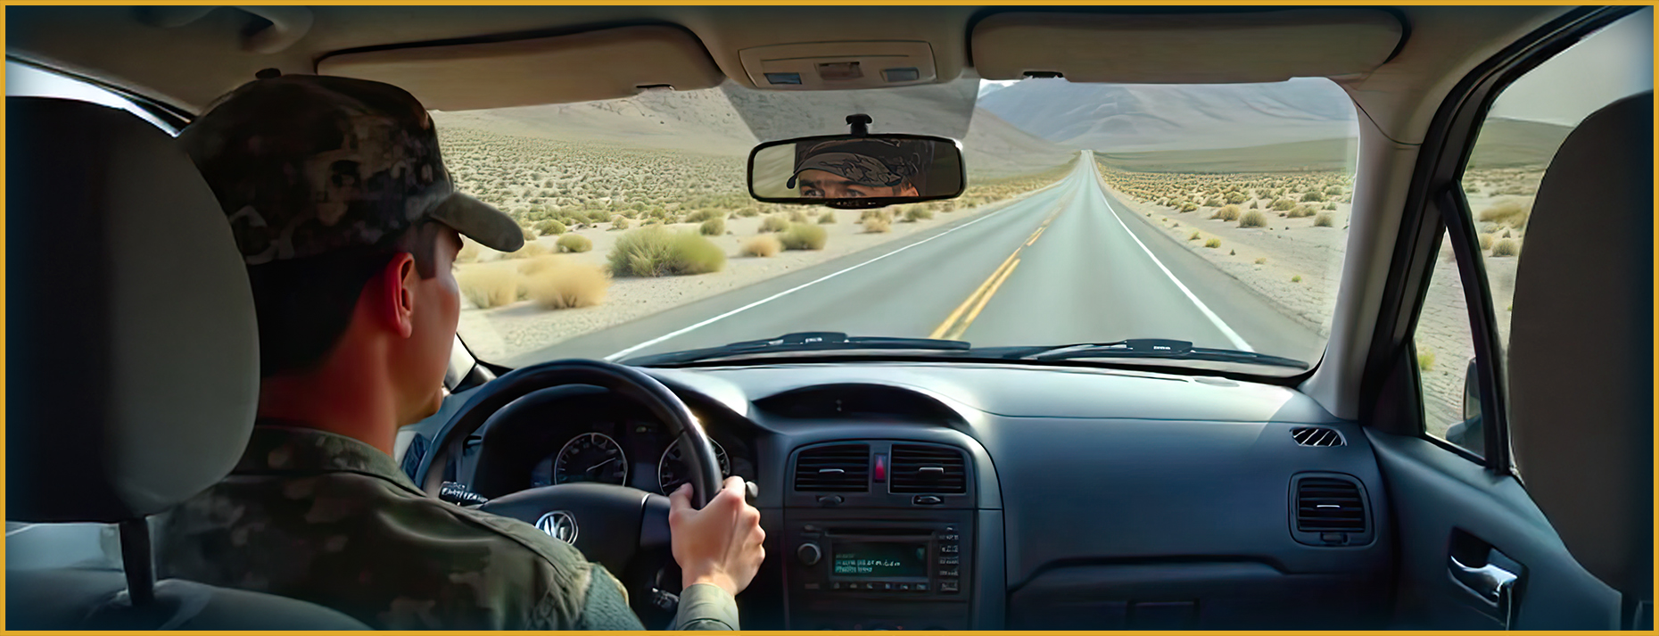
Mindfulness
What do you think it means to be mindful?
Notes:
Facilitator Actions:
Display slide.
Discuss how graphic relates to topic.
Monitor the discussions of the Sailors.
Facilitator Content:
Discuss:
What do you think it means to be mindful?
How is that different from practicing mindfulness?
Inform:
Being mindful means to be momentarily aware and attentive. Practicing mindfulness is achieving and maintaining present moment awareness. This happens when a Sailor reaches a heightened mental state by focusing on their own awareness and living in the moment. When a Sailor is on autopilot, they are not being mindful in the tasks they perform. These are actions done out of habit such as brushing their teeth or driving a car.
Discuss:
What are other examples of actions you tend to perform while on personal autopilot?
Inform:
Our minds are distracted or wandering 50% of the time. Research has shown that even mindfulness experts can only focus on one singular thing for a period of 7 seconds at a time. Mindfulness does not mean focusing longer, but rather increasing awareness when focus is lost. This allows for a quicker return to the task at hand.
Reference:
Jha, Amishi P., Peak Mind: Find Your Focus, Own Your Attention, Invest 12 Minutes a Day, 2021

Slide 6
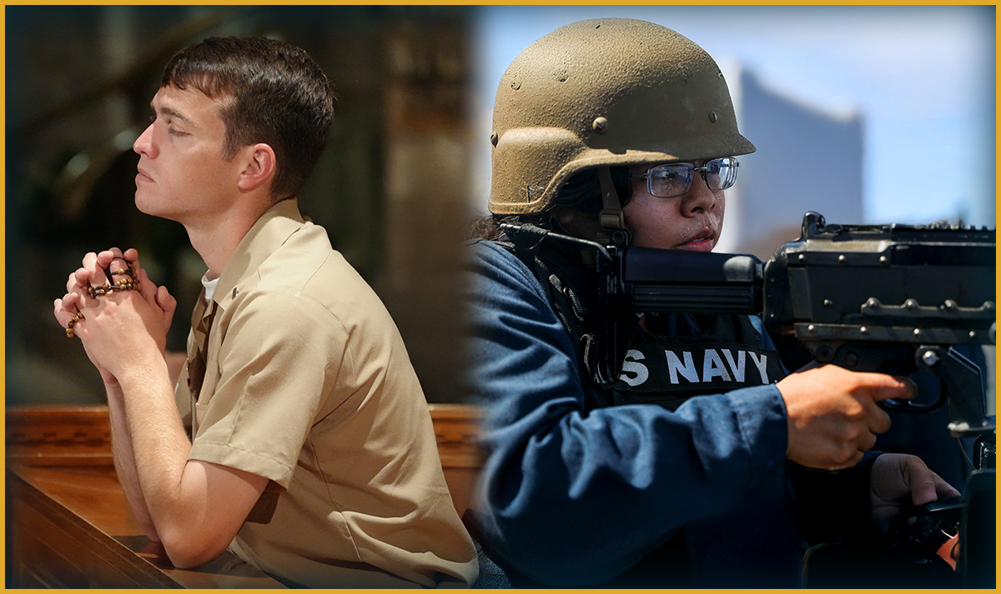
Self-Awareness and Situational Awareness
What do you think the difference is between self-awareness and situational awareness?
“Wherever you are, be there totally.” - Eckhart Tolle, 30 Most Powerful Mindfulness Quotes to Combat Stress
Notes:
Facilitator Actions:
Display slide.
Discuss how graphic relates to topic.
Monitor the discussions of the Sailors.
Facilitator Content:
Discuss:
What do you think the difference is between self-awareness and situational awareness?
Inform:
Present moment awareness is a combination of self-awareness and situational awareness.
Self-awareness is the inner awareness of a Sailor’s thoughts, emotions, bodily sensations, and self. Situational awareness is external awareness of the sights, sounds, and smells around the Sailor.
Practicing mindfulness has a lasting effect on a Sailor’s brain that changes the structure and networks to the brain. When a Sailor is experiencing a fight or flight response, it is important to be aware of what is happening internally and externally to help better manage the stress of the situation.
Reference:
https://vocal.media/motivation/30-most-powerful-mindfulness-quotes-to-combat-stress

Slide 7
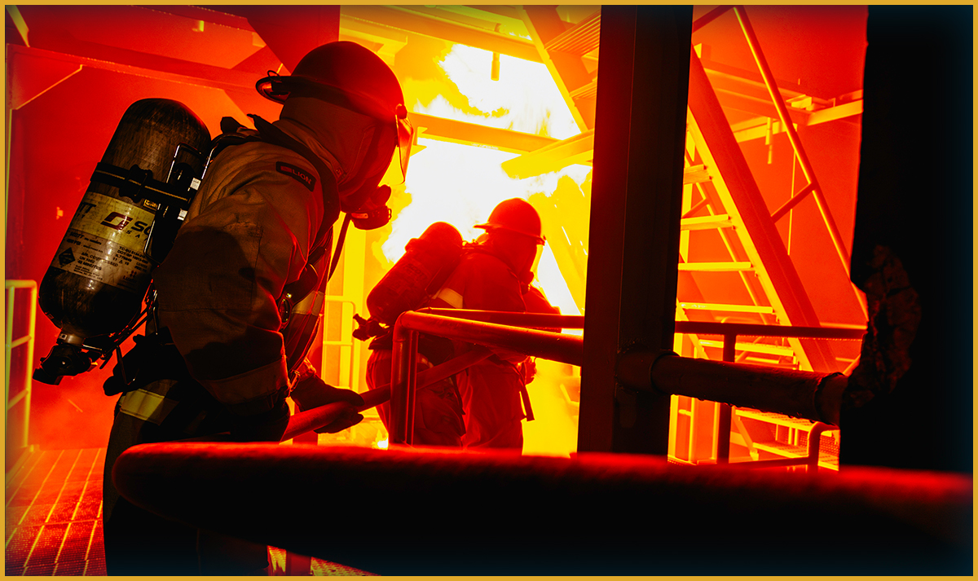
Building Resilience Through Mindfulness
How can mindfulness benefit you in both your personal and professional lives?
Mindfulness:
Improves emotional control
Reduces stress
Enhances focus and improves mental clarity
Builds self-awareness
Builds mental flexibility
Encourages self-recovery
Notes:
Facilitator Actions:
Display slide.
Discuss how graphic relates to topic.
Monitor the discussions of the Sailors.
Facilitator Content:
Inform:
Mindfulness can help Sailors manage stress and increase their resilience. Resilience is imperative in high-pressure environments such as during critical operations or while in combat.
Discuss:
How does mindfulness improve the Sailor’s ability to control emotions? Answer: Mindfulness enhances the Sailor’s emotions by helping them observe and manage their emotional reactions.
How does mindfulness reduce the impact of stress on the body? Answer: Mindfulness actively reduces stress hormone levels and calms the nervous system.
How does mindfulness enhance the Sailor's ability to focus and improve their mental clarity? Answer: Mindfulness trains Sailors to focus their brain to stay in the present and reduce distractions.
How does mindfulness build the Sailor’s personal self-awareness? Answer: Mindfulness creates self-awareness and helps Sailors understand the effects of stress and determine which strategies should be used to manage it.
How does mindfulness build the Sailor’s mental flexibility? Answer: Mindfulness heightens the Sailor’s ability to solve problems and increases their ability to adapt in stressful situations by improving their mental flexibility.
How does mindfulness encourage the Sailor’s relaxation and self-recovery? Answer: The practice of being mindful triggers the relaxation response in the Sailor’s body and provides a way for them to recover from stressful situations.
Inform:
Mindfulness takes practice to become an everyday skill.
Stress can be managed through the act of mindfulness and being present in the moment.
Practicing daily mindfulness assists in building personal resilience to stressful situations.
Discuss:
How can mindfulness benefit you in both your personal and professional lives?

Slide 8

Mental Time Travel
What is mental time travel?
Notes:
Facilitator Actions:
Display slide.
Discuss how graphic relates to topic.
Monitor the discussions of the Sailors.
Facilitator Content:
Discuss:
What is mental time travel?
Inform:
Mental time travel is the habit of thinking about the past or the future instead of focusing on the present and can be detrimental during moments of stress. The action of mental wondering degrades the Sailor’s attention span and increases stress levels.
Discuss:
What are examples of mental time travel you have experienced during your workday and at home?
Inform:
Practicing mindfulness stabilizes the Sailor’s ability to focus and allows them to perform better while under stress. Research states the average person needs to practice mindfulness 3–4 times per week for 12 minutes to improve functionality while dealing with stressful situations.
Reference:
Jha, Amishi P., Peak Mind: Find Your Focus, Own Your Attention, Invest 12 Minutes a Day, 2021

Slide 9
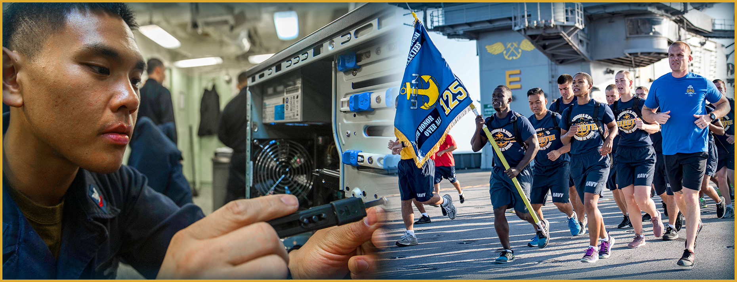
Physical and Mental Toughness
What is the difference between mental training and Physical Training (PT)?
Notes:
Facilitator Actions:
Display slide.
Discuss how graphic relates to topic.
Monitor the discussions of the Sailors.
Facilitator Content:
Discuss:
What is the difference between mental training and Physical Training (PT)?
Inform:
PT strengthens the body whereas mental training strengthens the mind. Practicing mindfulness is a great way to exercise the mind.
Warrior Toughness states that practicing mindfulness needs to be done to strengthen Sailors’ brains. The frontal cortex of the mind is just as formidable a weapon as any firearm, and Sailors need to keep it loaded to outsmart their enemies.

Slide 10
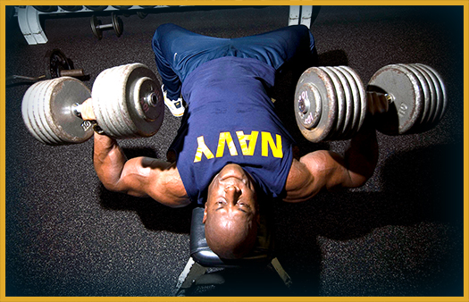
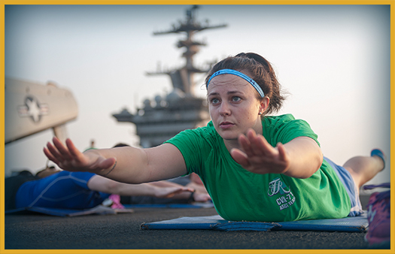
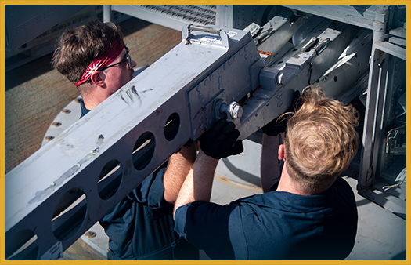
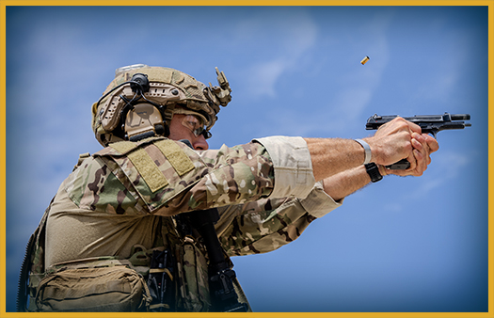
Preparation Versus Execution
What is the difference between preparation and execution?
Notes:
Facilitator Actions:
Display slide.
Discuss how graphics relate to topic.
Monitor the discussions of the Sailors.
Facilitator Content:
Inform:
Similar to how push-ups strengthen the Sailor’s arms, mindfulness exercises strengthen the Sailor’s ability to focus while under pressure.
Discuss:
What is the difference between preparation and execution?
Inform:
Physical preparation is done through intentional repetition, such as building physical strength through PT. Physical execution is performing acts of strength such as Sailors lifting heavy objects or rescuing other Sailors from the water.
Mental preparation is achieved through intentional repetition of mindfulness exercises. This practice makes a difference when Sailors are tasked with demonstrating mental execution while performing under pressure and managing their emotions.
Discuss:
What are some examples of mental preparation that can be performed daily?
Inform:
The effects of practicing mindfulness may not be apparent at first. It takes consistency and repetition to build mindfulness in the same way it takes time to build muscle through working out. Finding types of mindfulness activities that are enjoyable is important to ensure they will continue to be practiced. This is similar to having a preference for certain types of physical exercise such as running, swimming, and weightlifting.

Slide 11
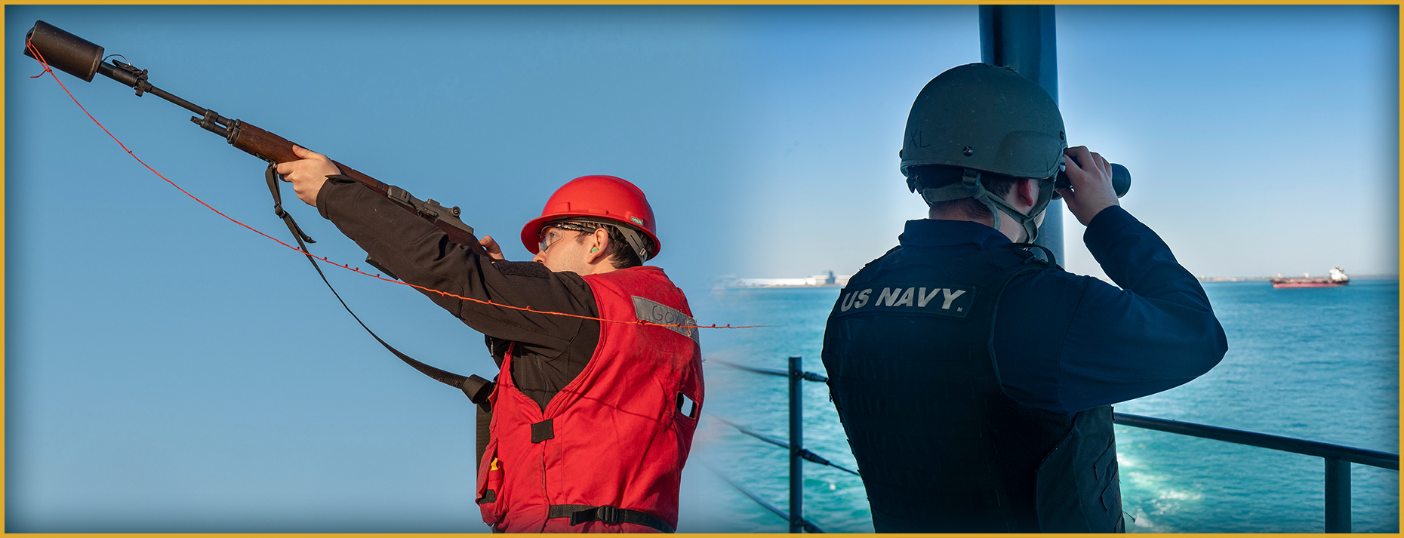
Core Steps of Mindfulness
What are some internal and external things you can focus on when starting a mindfulness exercise?
Notes:
Facilitator Actions:
Display slide.
Discuss how graphic relates to topic.
Monitor the discussions of the Sailors.
Facilitator Content:
Inform:
There are many types of mindfulness exercises, and they all require two core steps:
Focus on something in the present moment.
Refocus when your mind starts to wander.
When starting to focus, choose something either internal, such as your breath, heartbeat, thoughts, or other physical sensations or something external such as sights, sounds, and smells that are within range to focus on.
Discuss:
What are some internal and external things you can focus on when starting a mindfulness exercise?
Inform:
It is totally normal while focusing for our minds to wander and for our focus to shift to something else. In that instance, it is important to realize what is happening and refocus attention on the task at hand without feeling negatively for losing focus.

Slide 12
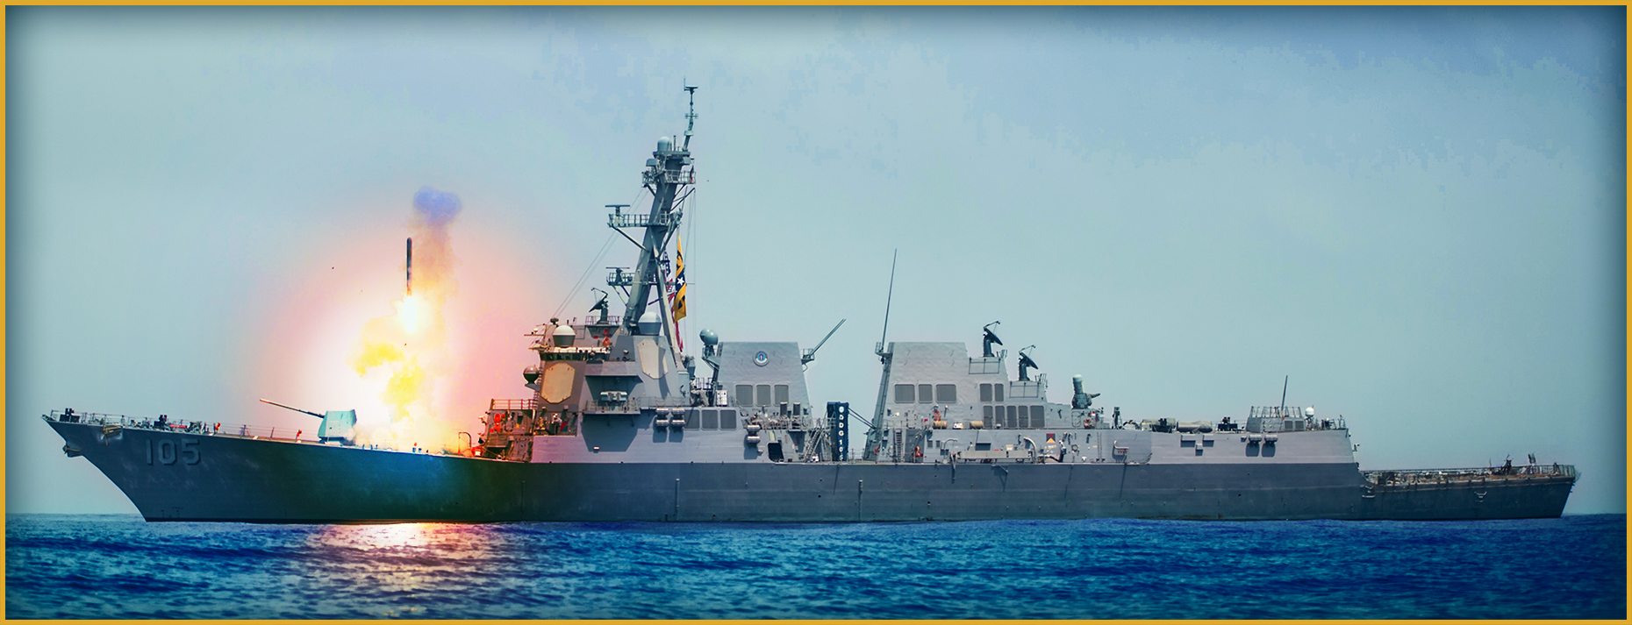
Mindful Execution
What do you think mindful execution is?
Notes:
Facilitator Actions:
Display slide.
Discuss how graphic relates to topic.
Monitor the discussions of the Sailors.
Facilitator Content:
Discuss:
What do you think mindful execution is?
Inform:
Mindful execution is achieved through the action of repeated mindfulness exercises. Sailors can only perform to the level they are trained. Self-training requires consistency, repetition, and focus. Much like physically working out muscles, it is important to start small and work up to longer periods of exercise. Imagine performing a mental push-up every time a mindfulness exercise is completed. Just as doing a physical push-up is the simple motion of arms bending and straightening, doing a mental push-up is focusing and refocusing as needed and the more repetitions performed the stronger the Sailors’ minds will become.
Finding mindfulness exercises that are fun or productive will increase the chance of performing them regularly. As previously mentioned, the goal is 3–4 times a week for at least 12 minutes at a time. Sailors may only be able to focus for 2–3 minutes to start, but through practice that time will increase.
Reference:
Jha, Amishi P., Peak Mind: Find Your Focus, Own Your Attention, Invest 12 Minutes a Day, 2021

Slide 13
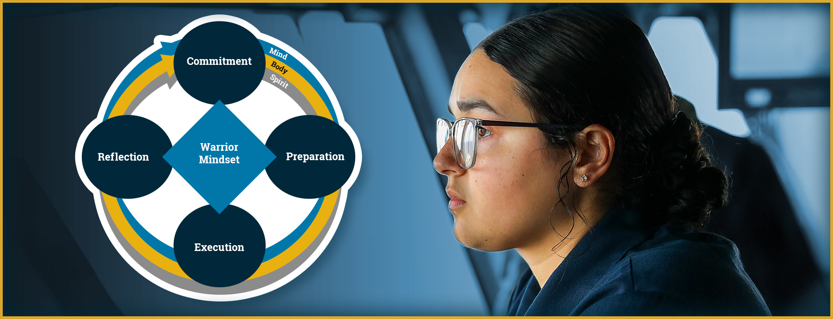
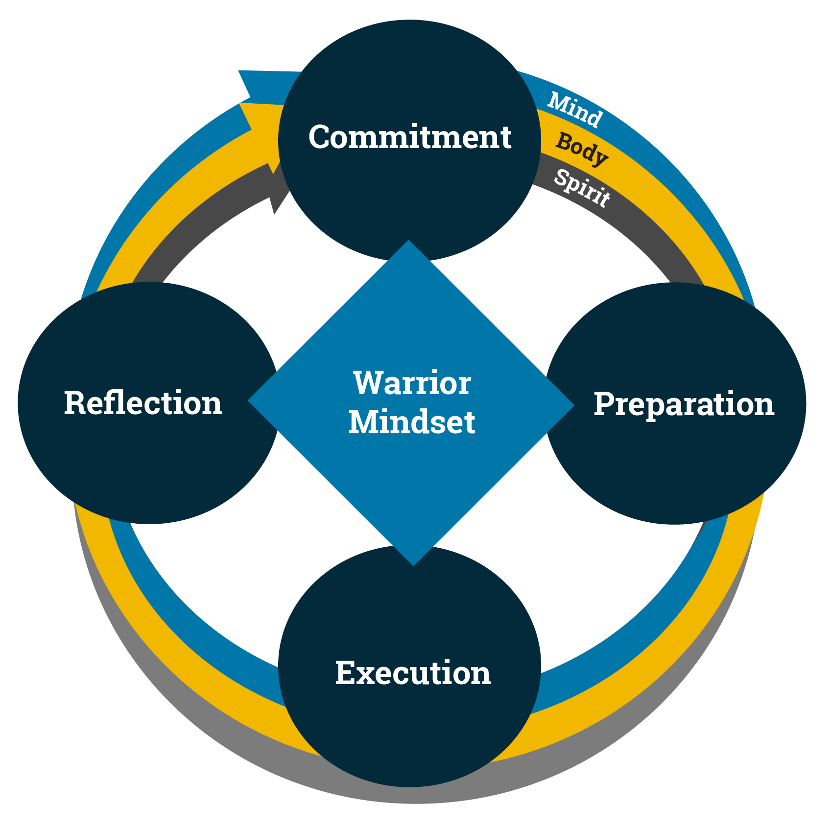
Warrior Mindset and Mindfulness
How can the act of a wandering mind become a potential risk during a critical mission?
Notes:
Facilitator Actions:
Display slide.
Discuss how graphic relates to topic.
Monitor the discussions of the Sailors.
Facilitator Content:
Discuss:
How can the act of a wandering mind become a potential risk during a critical mission?
Inform:
Mindfulness training minimizes possible distractions and improves execution when Sailors are under pressure.
Discuss:
On average, how often do our minds wonder?
Inform:
As previously stated, the mind wanders on average approximately 50% of the time. This means while Sailors are performing a task, their mind will change focus. For example, many people look at their phone while they are eating. This action of split focus may take away from the taste of the food or the feeling of being full.
Discuss:
If a Sailor is not focusing while on watch, what can happen to them or other Sailors?
Inform:
When Sailors are practicing mindfulness, they are doing so not only for themselves, but also for the lives of their fellow Sailors. Being on autopilot and practicing mindfulness can be the difference between life and death.
To perform with a Warrior Mindset, the execution of mindfulness is key. Reflection is focusing on the past and preparation is focusing on the future. Mindfulness exercises are performed during the preparation stage of the cycle. These exercises assist Sailors in staying focused during execution and demonstrating a Warrior Mindset.

Slide 14

Call to Action
Maximize your focus, resilience, and performance with mindfulness!
Notes:
Facilitator Actions:
Display slide.
Review topics discussed and ask if there are any questions.
Check Sailor comprehension by providing review questions and/or problems.
Discuss how the call to action supports and encourages Sailors’ post training.
Relate call to action to Warrior Toughness.
Facilitator Content: N/A

Slide 15
References
Tools and Resources
MHS DHA App Library, Breathe2Relax
U.S. Department of Veterans Affairs, (Download) Mindfulness Coach App
Motivation, 30 Most Powerful Mindfulness Quotes to Combat Stress
Naval Medical Center San Diego, The Mind-Body-Medicine Program
Military OneSouce, Chill Drills
Jha, Amishi P., Peak Mind: Find Your Focus, Own Your Attention, Invest 12 Minutes a Day, 2021
Defense Visual Information Distribution Service, (Podcast) Military Meditation Coach
Notes:
Facilitator Actions:
Display slide.
Facilitator Content:
Inform:
- Identify tools.
- Identify resources.

Slide 16
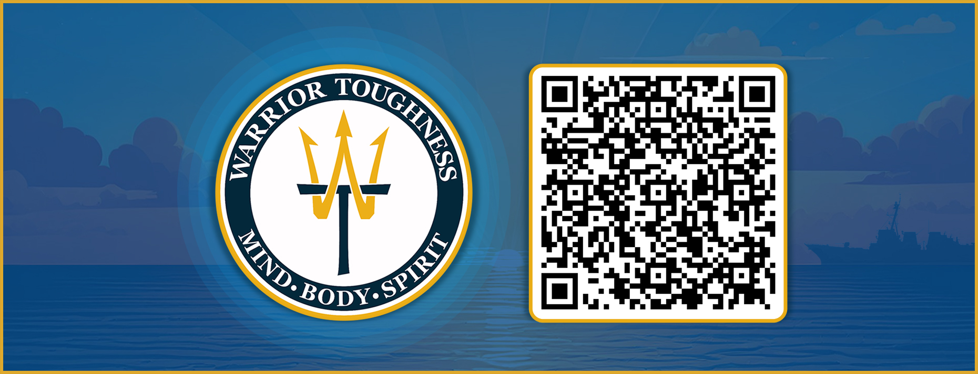
Warrior Toughness QR Code
Notes:
Facilitator Actions:
Display slide.
Facilitator Content:
Inform:
Identify Warrior Toughness QR code.

Slide 17
Glossary
Glossary
Acronym | Term
PT | Physical Training
WT | Warrior Toughness
Notes:
Facilitator Actions:
Display slide.
Facilitator Content: N/A

